Slide 1
Data Collection Methods (I) (CSC/MIS316) Lecture 8
Iheanetu, O.U. (Ph.D)

Slide 2
Learning objectives
Importance of data collection in a research study
Methods of data collection
Advantages and disadvantages of types data collection
Choosing appropriate data collection method for your study

Slide 3
Learning Outcome
At the end of this class, students should be able to:
State the importance of data collection in a research study
List and describe the methods of data collection
List the various data collection tools
Explain the sources of data collection
Choose appropriate data collection method for your study

Slide 4
Introduction
Data is the basic and core element for any research.
Effective access to useful and sufficient data has always been a major issue for researchers
Any research is only as good as the data that drives it, so choosing the right technique of data collection can make all the difference

Slide 5
Definition
Data collection is a process of collecting information (data) from all the relevant sources in order to find answers to the research problem, test the hypothesis and evaluate the outcomes.
Data collection is a systematic process of gathering information for research
Data collection is the procedure of collecting, measuring and analyzing accurate insights for research using standard validated techniques

Slide 6
Definition Cont’d
Data collection is very important in any research study because the outcome of your research study largely depend on the quality of your data.
The most critical objective of data collection is ensuring that information-rich and reliable data is collected for analysis so that data-driven decisions can be made for research.

Slide 7
Choice of Method of Data collection
The choice of a method of data collection depends upon
The purpose of the study,
The resources available and
The skill of the researcher.

Slide 8
Importance of Data Collection
Integrity of the Research
A key reason for collecting data is to ensure that the integrity of the research question is maintained.
Reduce the likelihood of errors
The correct use of appropriate data collection of methods reduces the likelihood of errors consistent with the results.
Decision Making
To minimize the risk of errors in decision making, it is important that accurate data is collected so that the researcher doesn't make uninformed decisions.

Slide 9
Save Cost and Time
Data collection saves the researcher time and funds that would otherwise be misspent without a deeper understanding of the topic or subject matter.
To support a need for a new idea, change and/or innovation
To prove the need for a change in the norm or the introduction of new information that will be widely accepted, it is important to collect data as evidence to support these claims.

Slide 10
Approaches/ Methods of Data Collection
Two broad approaches to data collection exist based on Two types of data:
Primary data (From Primary data sources)
Secondary data (From Secondary data sources)

Slide 11
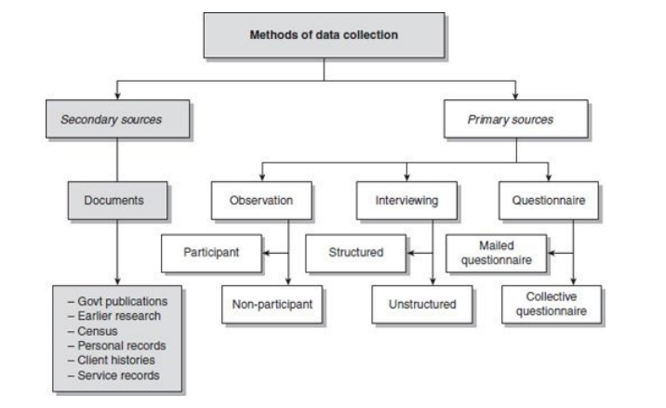
Methods of Data Collection

Slide 12
Primary data collection Method
Concerns gathering/ collection of Primary data (raw data) using primary data sources.
Collection of original data by a researcher for a specific research purpose.
Primary data is raw evidence/ original data
It could be qualitative or qualitative data collection methods

Slide 13
Examples of Primary Data Sources
Original Documents - including eyewitness accounts or the first record of events such as diaries, speeches, letters, manuscripts, interviews, news film footage, autobiographies, or official records
Creative Works such as literature, music, art, film, etc.
Relics or Artifacts such as pottery, furniture, clothing, and buildings
Data from original research whether statistical or scientific

Slide 14
Six Data collection Tools/ Techniques
Interviews
Questionnaires and surveys
Observations
Documents and records
Focus groups
Oral histories

Slide 15
Other Data Collection Tools
Sensor-based approaches allow for continuously collecting large amount of data.
Sensors
For example, by getting workers to wear activity-tracking wristbands, data about their movement, heart rate, and calories burned can be gathered.
Furthermore, wearable sensors can be used to collect data on moving objects’ physical proximity.
This data gathering approach is relatively nonobtrusive and provides information about employees in natural settings.
Used to monitor the work environment, e.g., temperature, humidity, light, and noise, or movements and gas consumption of vehicles (George et al. 2016).

Slide 16
Survey
Data collection method that gathers the thought, feeling, and emotion of certain groups of people regarding particular topics.
It includes but is not limited to
Questionnaires
Interviews
Document and archival records collection
Observation
Data companies.

Slide 17
Web crawlers
Are programs that allow for the automated extraction of large amounts of data from websites.
Web crawlers can be programmed to extract numeric data, textual data, audio data, and video data.
Often in the form of plugins for popular web browsers such as Google Chrome.
Some websites, e.g., Twitter, offer application program interfaces (APIs) to ease and streamline access to the contents on their websites.

Slide 18
Data Collection using Primary Sources
The following are techniques of data collection using primary sources.
Observation (participant/non-participant)
Interviewing (structured/unstructured)
Questionnaire (mailed/collective)

Slide 19
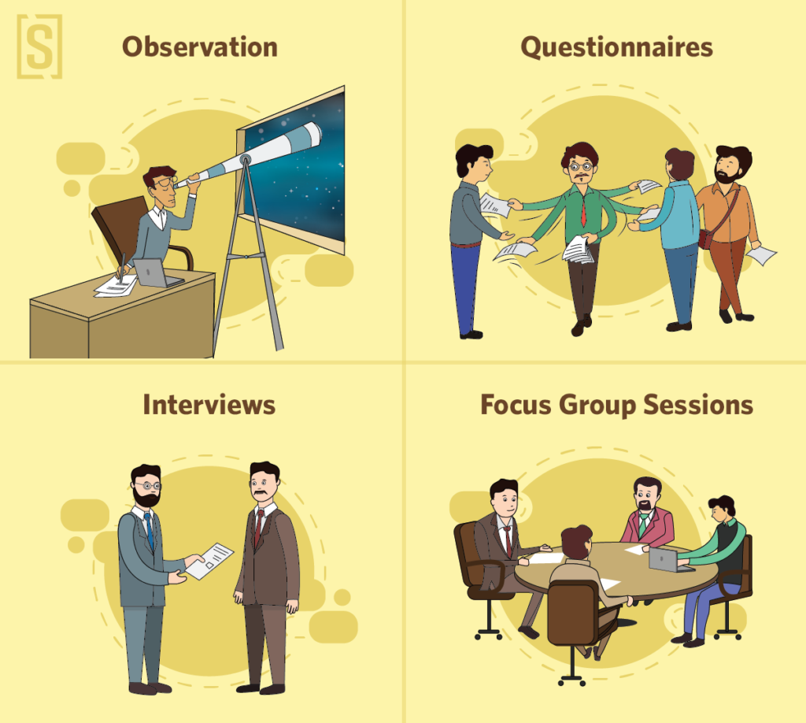

Slide 20
Observation
Observation is a systematic and selective way of watching and listening to an interaction or phenomenon as it takes place.
For example, study the dietary patterns of a population, or study behaviour or personality traits of an individual.
There are two types of observation as follows:
Participant observation and
Non-participant observation

Slide 21
Participant observation – is when you, as a researcher participate in the activities of the group being observed in the same manner as its member, with or without their knowing that they are being observed.
This can be obtrusive or unobtrusive
For example, you might want to examine the reactions of the general population towards people in wheelchairs. You can study their reactions by sitting in a wheelchair yourself.

Slide 22
Observation Cont’d
Non-participants – is when you, as a researcher, do not get involved in the activities of the group but remain a passive observer, watching and listening to its activities and drawing conclusions from this. This can be obtrusive or unobtrusive
For example, you want to study the functions carried out by a nurse in a hospital. As an observer, you could watch, follow, and record activities as they are performed.
After making a number of observations, conclusion could be drawn about the functions of nurses in hospital.

Slide 23
Scheduling Observations
Decide on the type of observation technique
Prepare a Schedule for observations
Decisions must be made regarding frequency, duration, and time of day for scheduling observations
Researchers may only be interested in a restricted, narrow time period, or they may be interested in a broad, representative time period.
These decisions depend upon the purposes to be served by the observations.

Slide 24
Choose between either of these methods of recording observation
Frequency method - the observer records the number of times that a defined behavior occurs
The observer simply counts the number of occurrences of the behavior of interest in a given interval of time.
Duration method - in which the observer records how long a defined behavior lasts
The observer records the beginning and the end of a particular behavior
Interval method - in which the observer determines whether or not a particular behavior occurs at specified intervals of time
The observation period is broken into equal intervals, the size of which varies with the particular observations of interest.
Behavior is recorded as occurring or not occurring in each interval.

Slide 25
Scheduling Observations
Define the behavior to be observed, and the aspect of the behavior to be observed.
It is important to define the dependent variable (behavior) in terms of specific observable responses and to specify clearly the criteria for judging when the behavior has occurred
Which data collection tools to be used- recorders, etc
Which setting will data be collected – Laboratory or Field settings
Decide which members of the population will be observed

Slide 26
Note the Following
A high measure of reliability across multiple observers enhances the objective nature of the research.
A low measure of reliability reduces confidence in the objectivity of the research.
All methods of data collection can occur either in a laboratory or in a field setting.
Laboratory affords more control over the environment,
Natural or field settings affords a more natural setting.
No matter the method of data collection or the setting, the researcher must decide which members of the population will be observed
It is important to define the dependent variable (behavior) in terms of specific observable responses and to specify clearly the criteria for judging when the behavior has occurred.
This is an important to ensure that different observers will make similar observations.

Slide 27
Problems of Observation as method of Data Collection:
When individual or groups become aware that they are being observed, they may change their behaviour, this is called Hawthorne effect. What is being observed, may not represent their normal behaviour.
There is always the possibility of observer bias.
The interpretation drawn from observation may vary from observer to observer.
There is the possibility of incomplete observation and /or recording which varies with the method of recording.
An observer may watch keenly at the expense of detailed recording and vice-versa.

Slide 28
Methods of Recording Observation
Narrative – researcher records a description of the interaction in his/her own words.
It provides a deeper insight into the interaction.
However, an observer may be biased in his/her observation
Interpretations and conclusions drawn are bound to be subjective reflecting the researcher’s perspectives
There is always the possibility of incomplete recording and/or observation
With different observers the comparability of narrative recording can be a problem.

Slide 29
Methods of Recording Observation
Scale – The use of a scale to rate various aspect of the interaction or phenomenon. A scale may be 1,2,3 depending on the purpose of study.
Removes the need to spend time taking detailed notes and thus, can concentrate on observation
However, scales do not provide specific and in-depth information about the interaction.
May suffer error of any of the following errors
Error of Central Tendency - avoiding the extreme positions on the scale & using mostly the central part.
Elevation Effect - tendency to use a particular part of the scale in recording an interaction,
Halo Effect – when a researcher’s rating of an individual on one aspect of the interaction influences the way s/he rates that individual on another aspect of another interaction.

Slide 30
Methods of Recording Observation
Categorical recording – recording an observation using categories
The type and number of categories depend upon the type of interaction and the observer’s choice about how to classify the observation. Examples
Two categories - passive/active;
Two categories - introvert/extrovert;
Three categories always/sometimes/never;
Five categories - strongly agree/agree/uncertain/disagree/strongly disagree
The use of categories to record an observation may suffer from the same problems as scales

Slide 31
Recording on mechanical devices – observation could be recorded on videotape and then analyzed.
An observer can see the recording a number of times before interpreting an interaction or drawing any conclusions from it
Other professionals can be invited to view the interaction in order to arrive at more objective conclusions.
However, It could make some people feel uncomfortable or force a different behaviour before a camera.
Therefore, the interaction may not be a true reflection of the situation

